Slide 1
Credibility of a Chief vs E7
Module 3.0
2022 Version 3.0
3-1

Slide 2
Credibility of a Chief vs E7
Objectives
3.0a Analyze and discuss the importance of the credibility of a Chief Petty Officer as it relates to the CPO Creed.
3.0b Analyze and discuss the definition of CREDIBILITY and how it relates to Chief Petty Officers in our ability to lead up, down, laterally and across the organization.
3.0c Analyze and discuss the unique responsibilities and privileges of a United States Navy Chief Petty Officers.
3.0d Analyze and discuss the differences between a United States Navy Chief Petty Officer and an E7 in the other services.
3-2

Slide 3
Overview
Credibility of a Chief vs E7
CPO Profile Video
CPO Creed – Section 4
Definition of CREDIBILITY
Unique responsibilities and privileges
Responsibilities and Privileges
Practical Exercise One
Practical Exercise Two
How a CPO differs from E7s of other services
Naval History Timeline
3-3

Slide 4
Credibility of a Chief vs E7

Slide 5
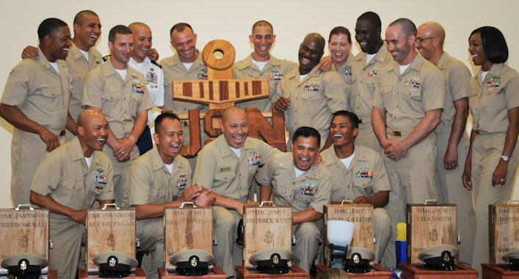
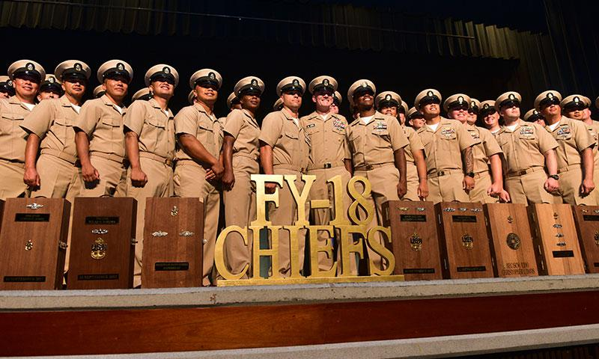
Credibility of a Chief vs E7
“By experience, by performance, and by testing, you have advanced to Chief Petty Officer. In the United States Navy – and only in the United States Navy – the rank of E7 carries with it unique responsibilities and privileges you are expected to fulfill and bound to observe. Your entire way of life has changed. More will be expected of you; more will be demanded of you. Not because you are an E7, but because you are now a Chief Petty Officer.”
CPO Creed
3-5

Slide 6
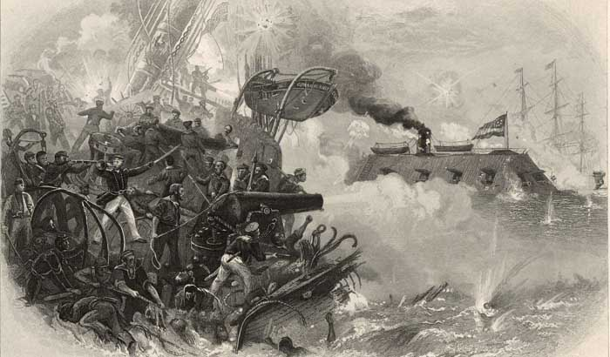
“CREDIBILITY”
Credibility of a Chief vs E7
Merriam-Webster:
“The quality of power of inspiring belief.”
Dictionary.com:
“The quality of being believed or worthy of trust.”
How do you build credibility?
3-6

Slide 7
Credibility of a Chief vs E7
“Building trust (credibility) requires nothing more than telling the truth.” Simon Sinek – Leaders Eat Last
Toxic behaviors:
-Is this a problem?
-How does toxic behavior affect the credibility of the CPO Mess?
Credibility comes from “walking the walk.”
3-7

Slide 8
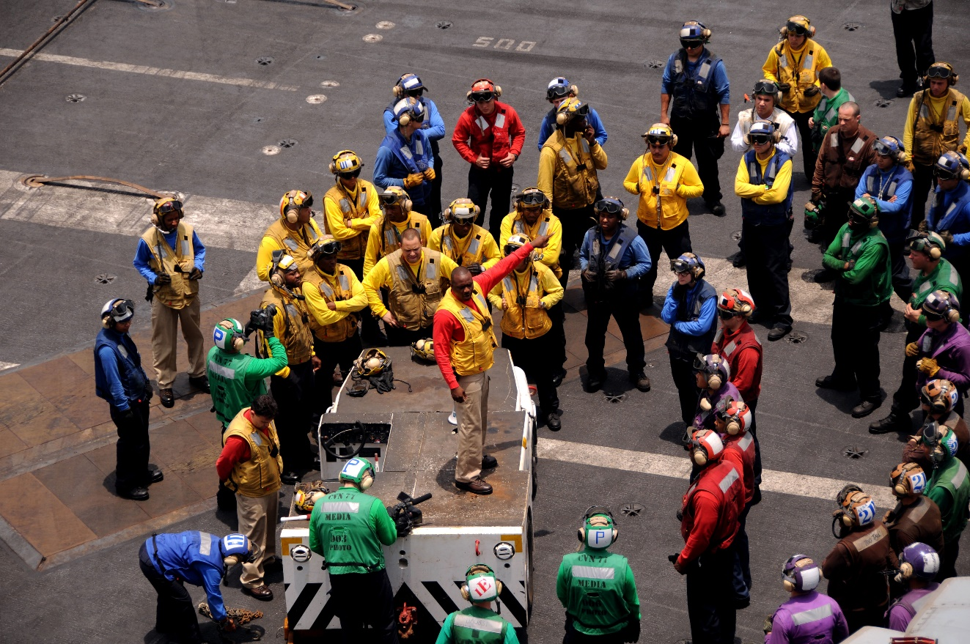
Credibility of a Chief vs E7
How does credibility, or lack thereof, impact the ability to lead…
Up
Down
Laterally and Across the organization
What’s the difference: loyalty to the institution vs individuals?
3-8

Slide 9
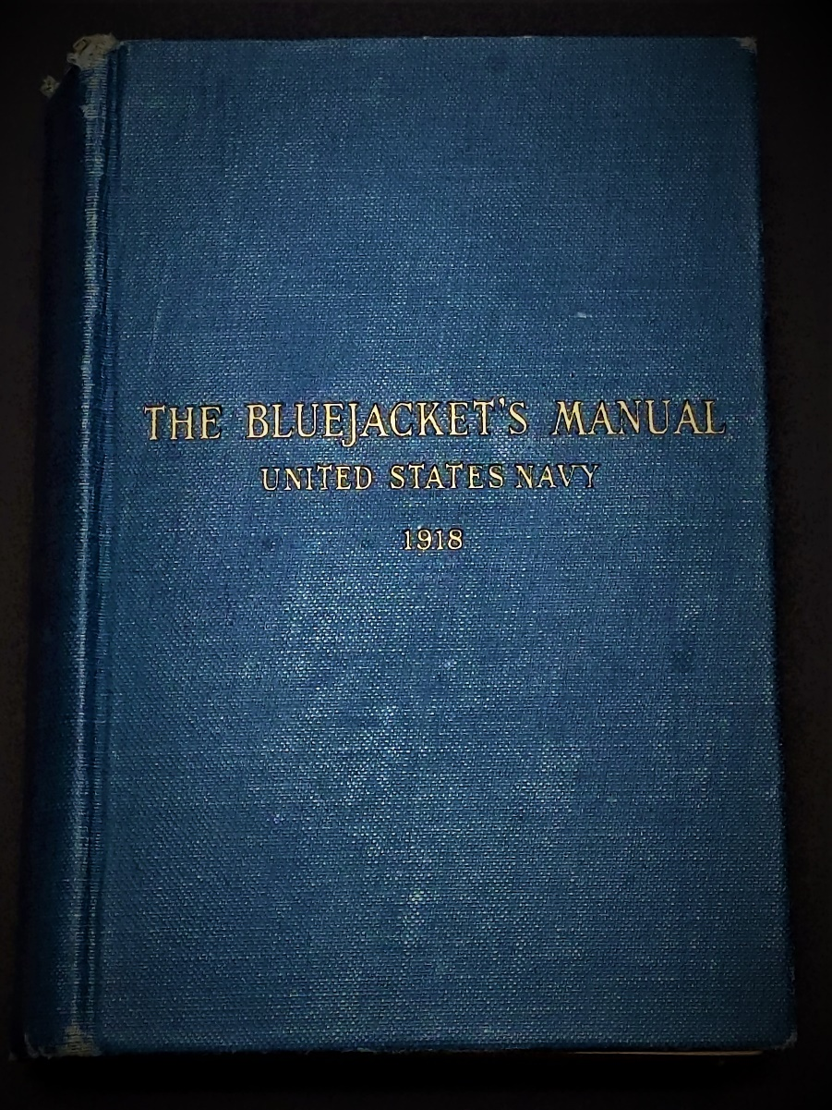
Responsibilities and Privileges
Credibility of a Chief vs E7
Read Part 4 of the 1918 Bluejacket’s Manual
Have our responsibilities changed all that much since 1918?
3-9

Slide 10
Responsibilities and Privileges Practical Exercise 1
Credibility of a Chief vs E7
Directions: Break up into groups. Each group will create a list of duties and responsibilities that pertain to a Chief Petty Officer.
3-10
Notes:
Practical Exercise: Break into groups and discuss. Write inputs on chart pack.

Slide 11
Navy Chief vs Other Service E7
Credibility of a Chief vs E7
Coast Guard E7: Technical specialist who train enlisted and junior commissioned ranks. Coast Guard CPOs can enforce disciplinary action. An E7 can command a small vessel or station.
Marine Corps E7: Gunnery Sergeants oversee firepower, weapons and operational planning for a company in both a physical and logistical aspect.
Air Force E7: Operational leaders and technical experts. Master Sergeants are superintendents in their chosen technical field.
Army E7: The platoon’s senior NCO. A Sergeant First Class is responsible for the personal and professional development of his or her soldiers.

Slide 12
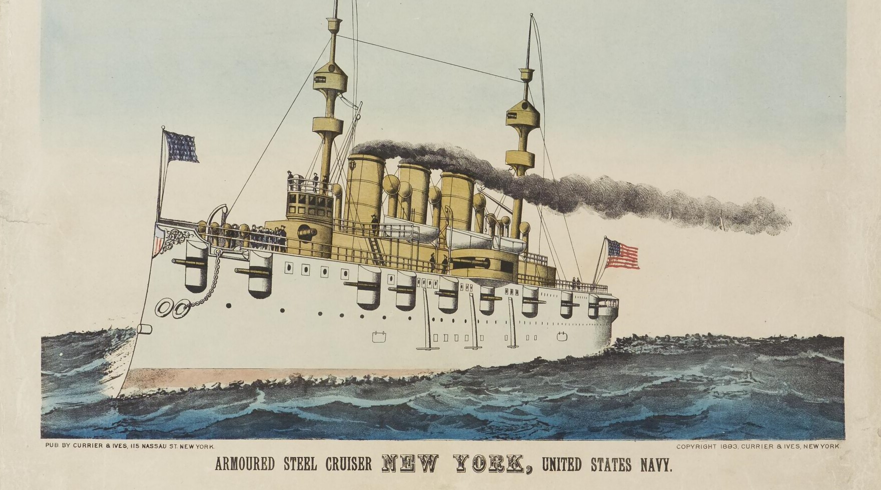
Navy Chief vs Other Service E7
Credibility of a Chief vs E7
Navy Chief Petty Officers are unique from the E7s of all the other uniformed services.
We have a unique service culture established in 1893, rich in heritage and tradition.
How do Navy Chiefs differ from the E7s of the other branches?
3-12
Notes:
Discuss differences/similiarities
Site personal examples (MSgt Chip White)

Slide 13
Practical Exercise Two: Sharing Personal Stories
As Chief Petty Officers in the Navy, you are the orators of Naval History. That also includes sharing your history, your past experiences. What knowledge have you gained through your experiences? Think of an instance in your career, one in which a Chief, or anyone serving in a leadership role, was forced to make an important decision in a stressful environment that resulted in a positive outcome. How did it affect you? Keep in mind the following:
Was the proper chain of command utilized?
Does the given scenario fall under a Chief’s umbrella of leadership?
Would the personal experience/scenario have applied to an E7 in the Coast Guard, Marines, Air Force or Army?

Slide 14
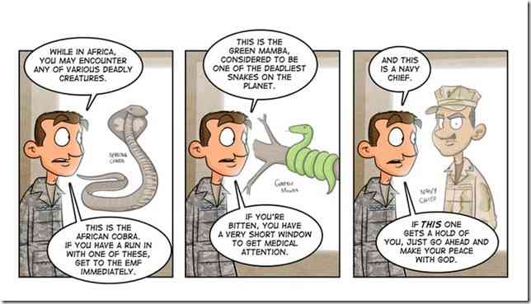
Navy Chief vs Other Service E7
Credibility of a Chief vs E7
3-14
Notes:
Discuss differences/similiarities
Site personal examples (MSgt Chip White)

Slide 15
Credibility of a Chief vs E7
The Difference Between a Chief and an E7
The Chief is always a part of the answer;
The E-7 is always part of the problem.
The Chief always has a program;
The E-7 always has an excuse.
The Chief says, "LET ME DO IT FOR YOU";
The E-7 says "That's not my job."
The Chief Sees an answer for every problem;
The E-7 sees a problem for every answer.
The Chief sees a green near every sand trap;
The E-7 sees a sand trap near every green.
The Chief says, "it may be difficult but it's possible";
The E-7 says,"it may be possible, but it's too difficult."
The Chief works harder than an E-7 and has more time:
The E-7 is always "too busy" to do what is necessary.
The Chief makes COMMITMENTS!
The E-7 makes Promises.
3-15

Slide 16
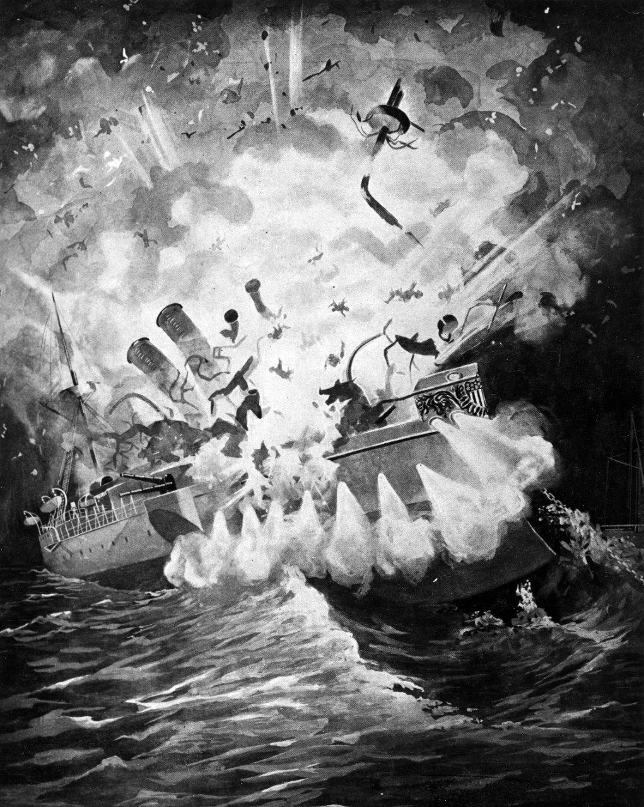
Important Dates in History: Naval History Timeline: Part 3
Credibility of a Chief vs E7
1862. On March 9, 1862, the second day of the Battle of Hampton Roads, the USS Monitor and CSS Virginia faced one another. The engagement marked a turning point in naval warfare, for it was the battle between two ironclad ships. The event ushered in a new era of naval technology and tactics.
1898. February 15. While in Havana Harbor, the USS Maine sunk after an explosion onboard. U.S. newspapers blamed Spain for the explosion. Two months later, the United States declared war on Spain. The Spanish-American War ended on December 10 with the signing of the Treaty of Paris. As a result, Spain lost what was left of its empire. (Image at right)

Slide 17
Summary
Credibility of a Chief vs E7
CPO Creed
Definition of CREDIBILITY
Unique responsibilities and privileges
How a CPO differs from E7s of other services
Personal experience
3-17

